Slide 1


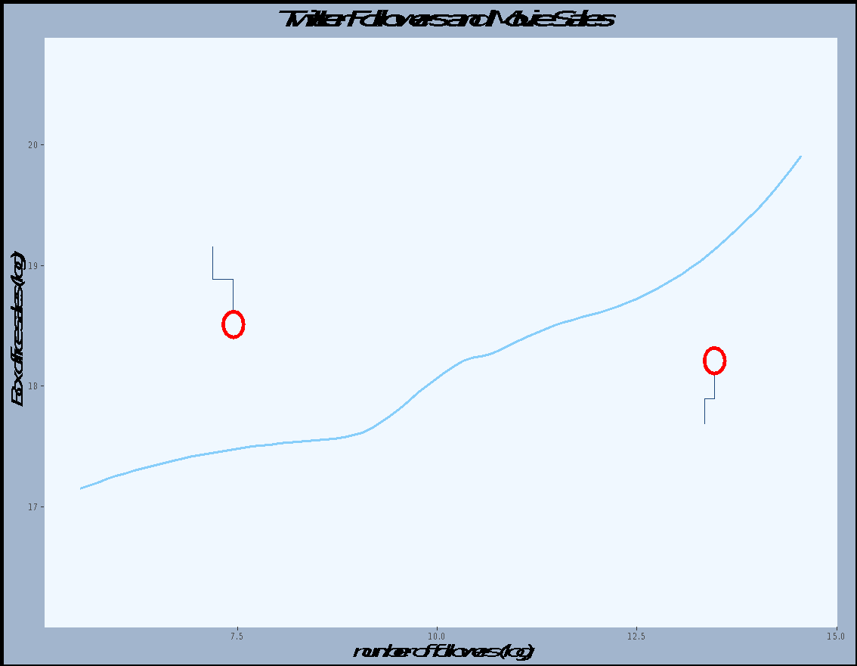
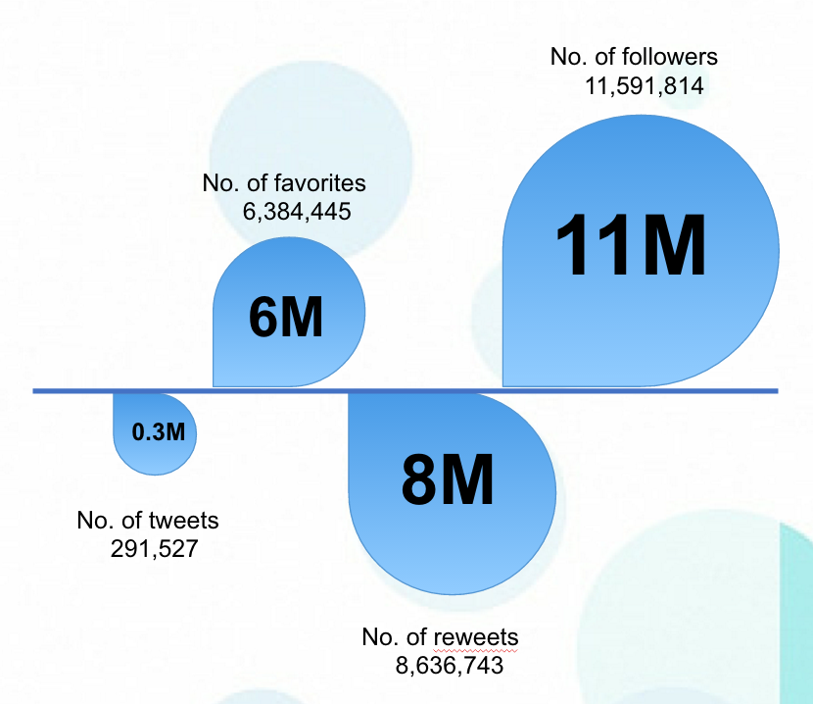
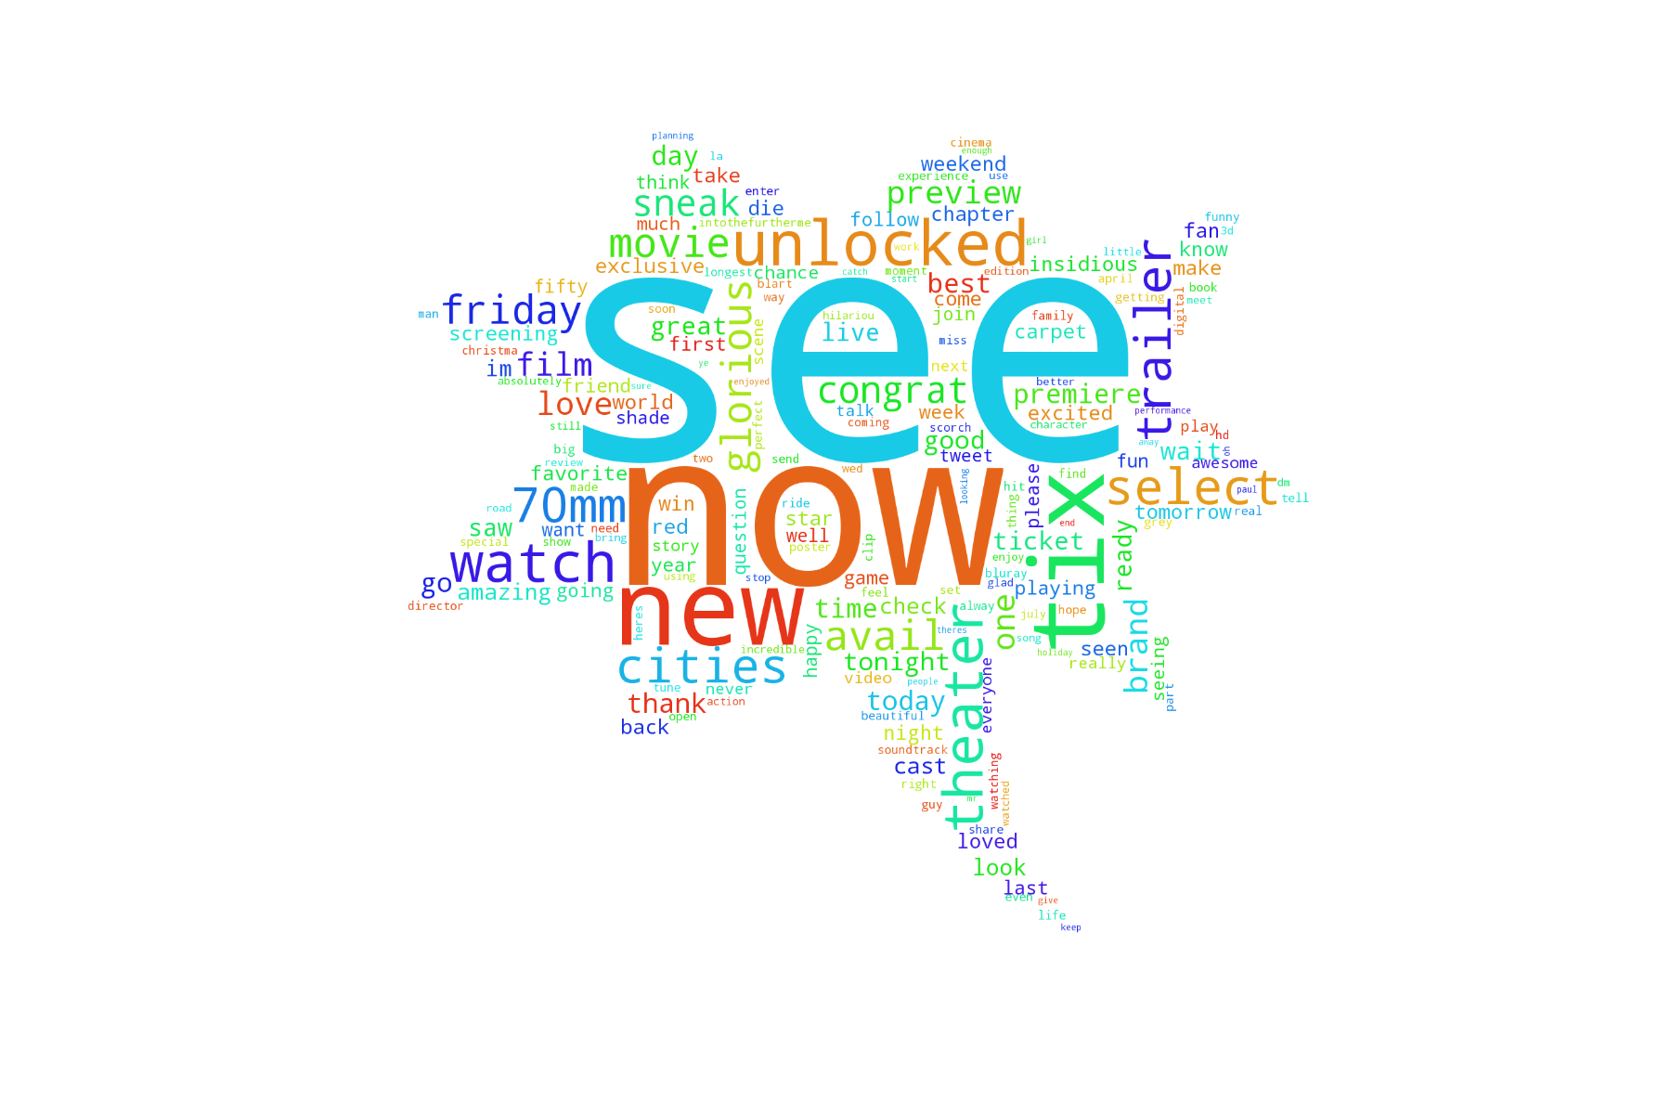
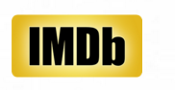
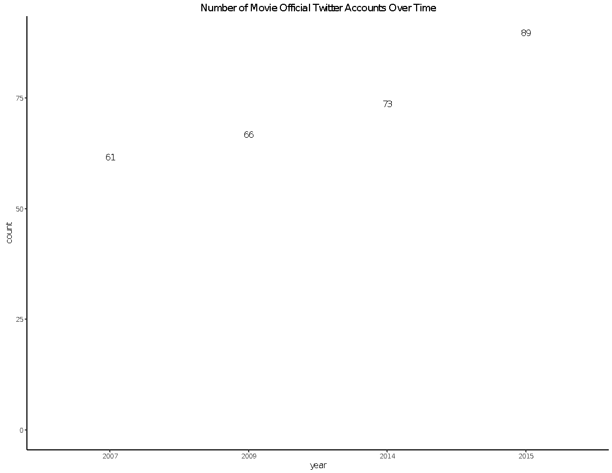
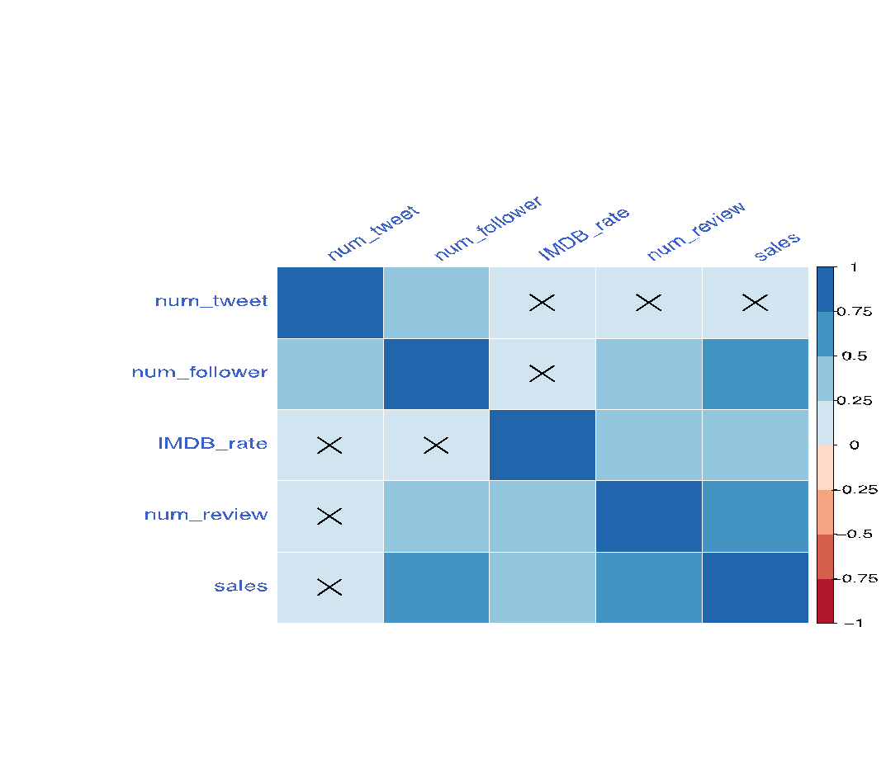
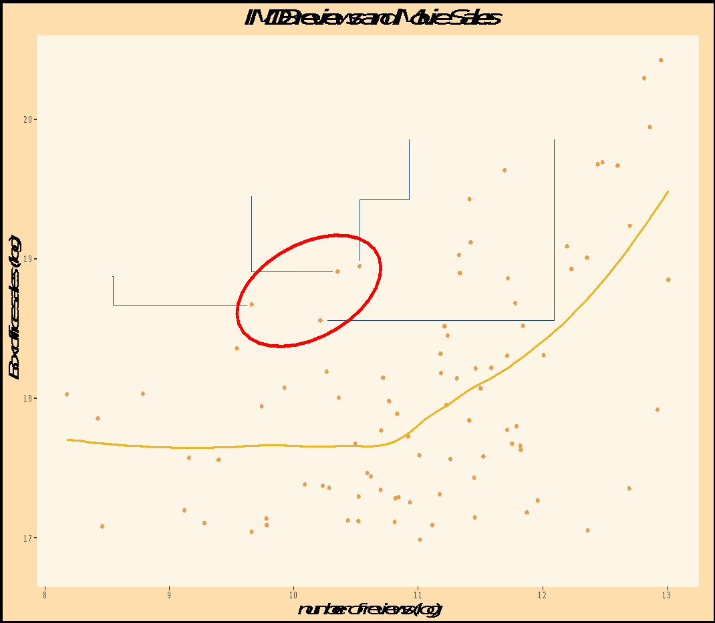
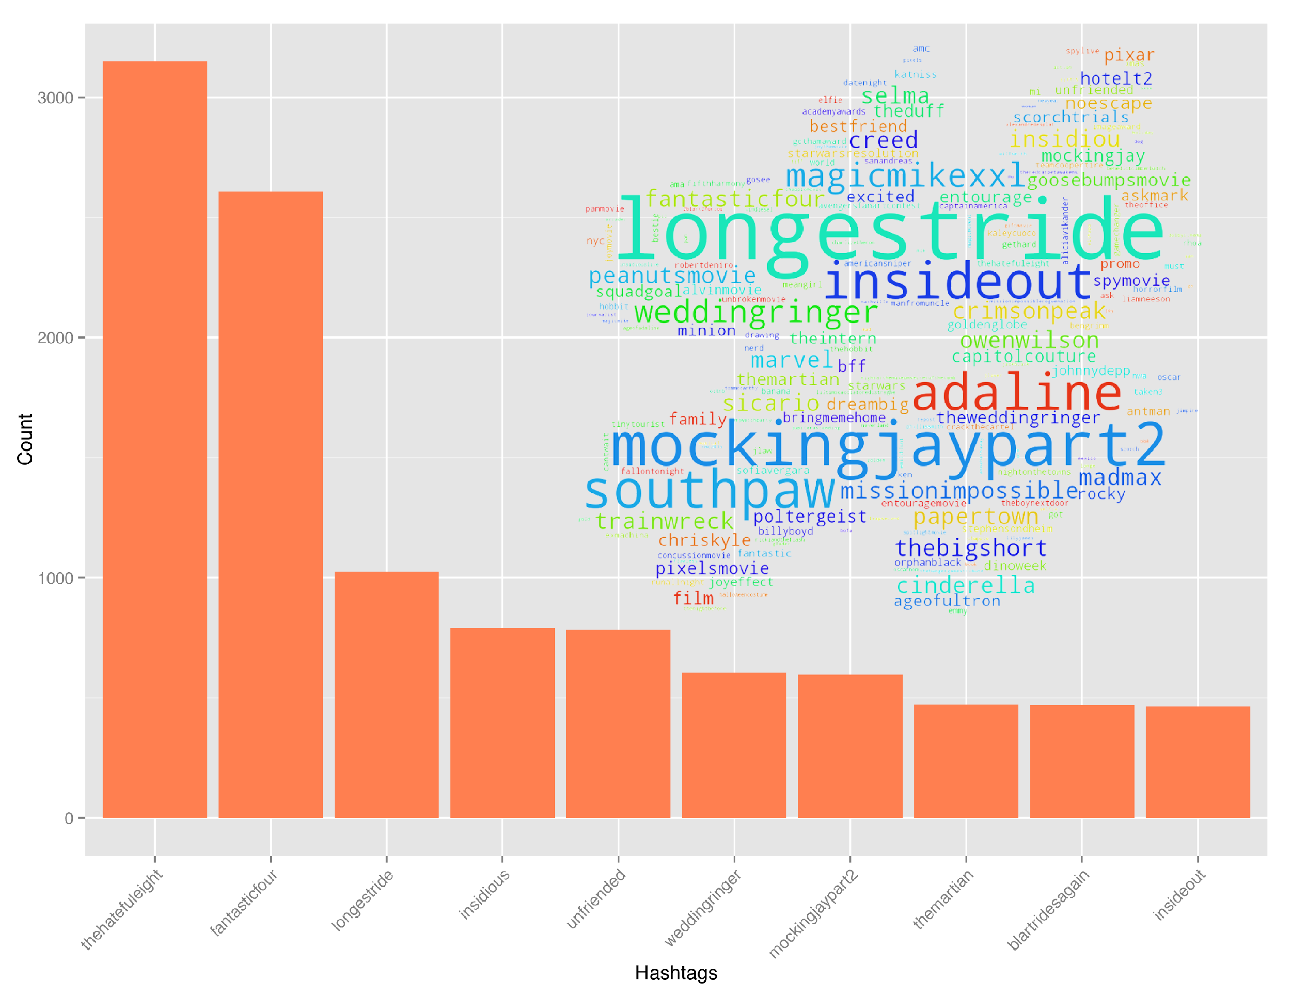
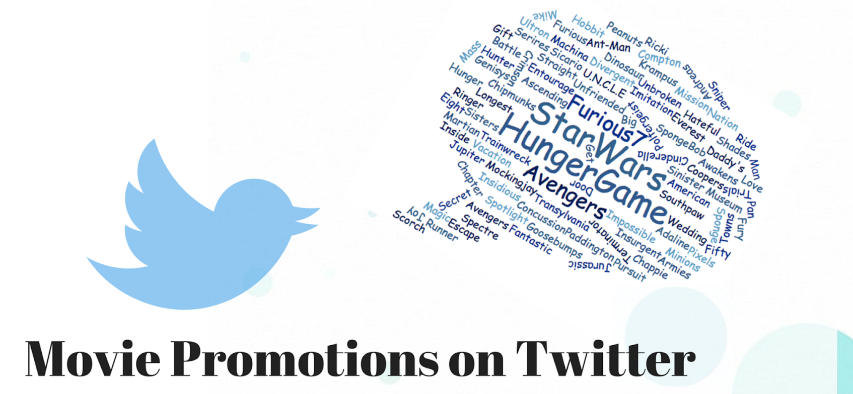
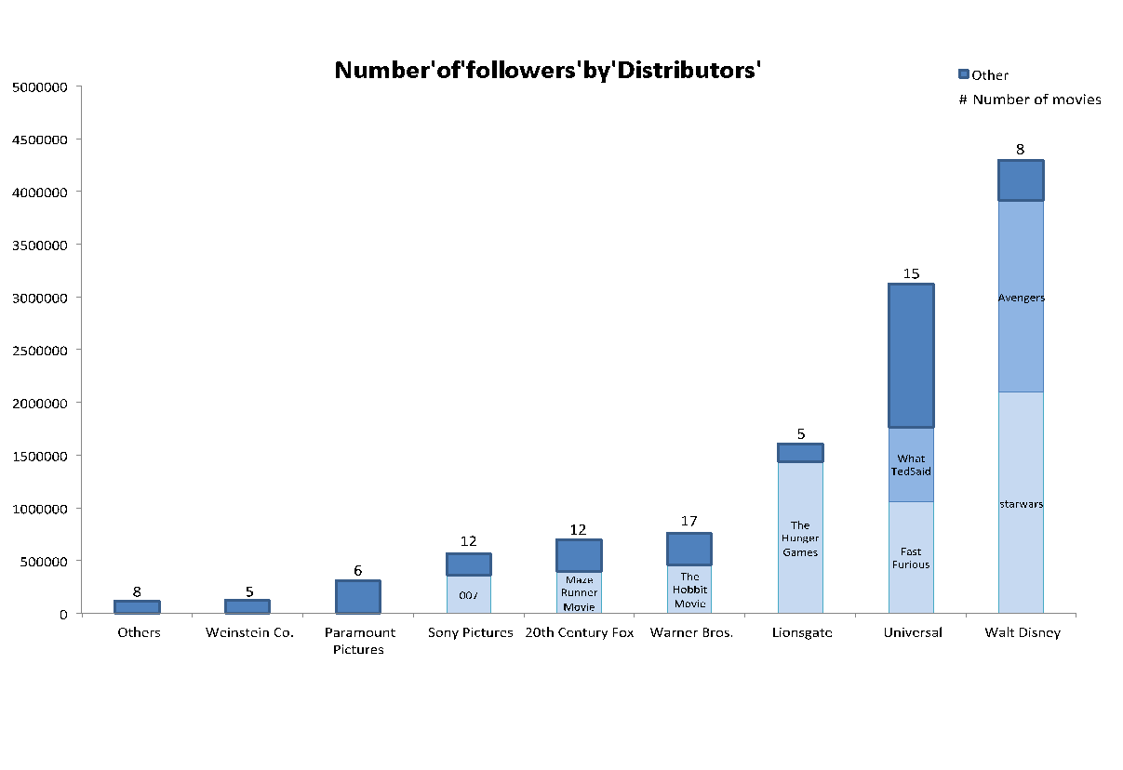
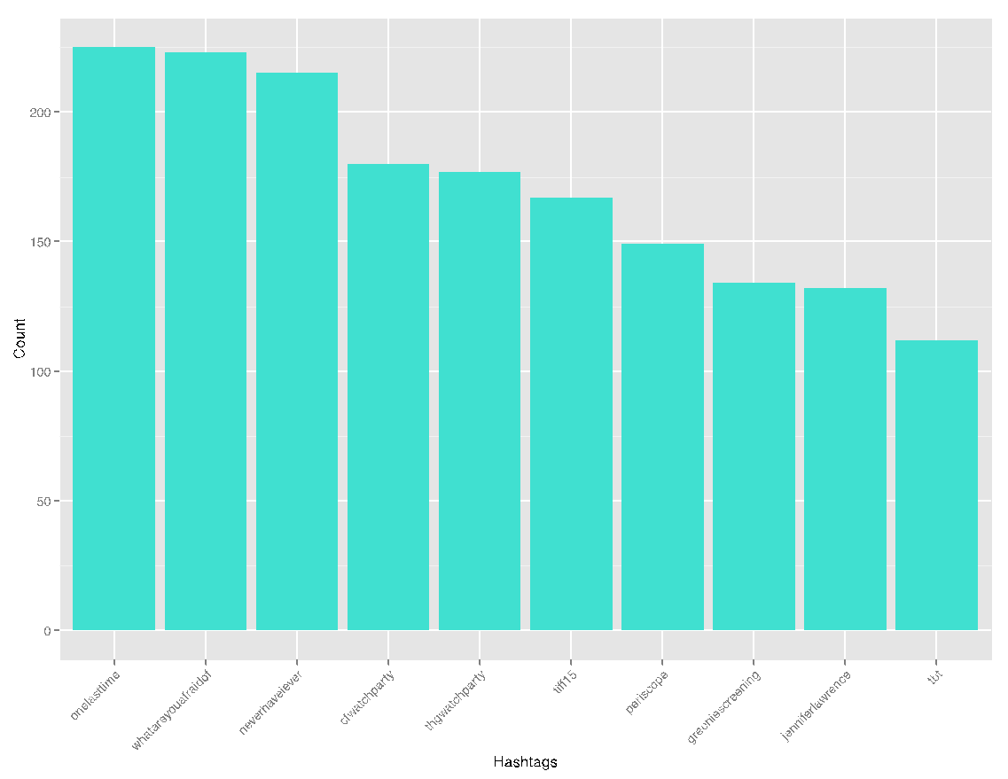
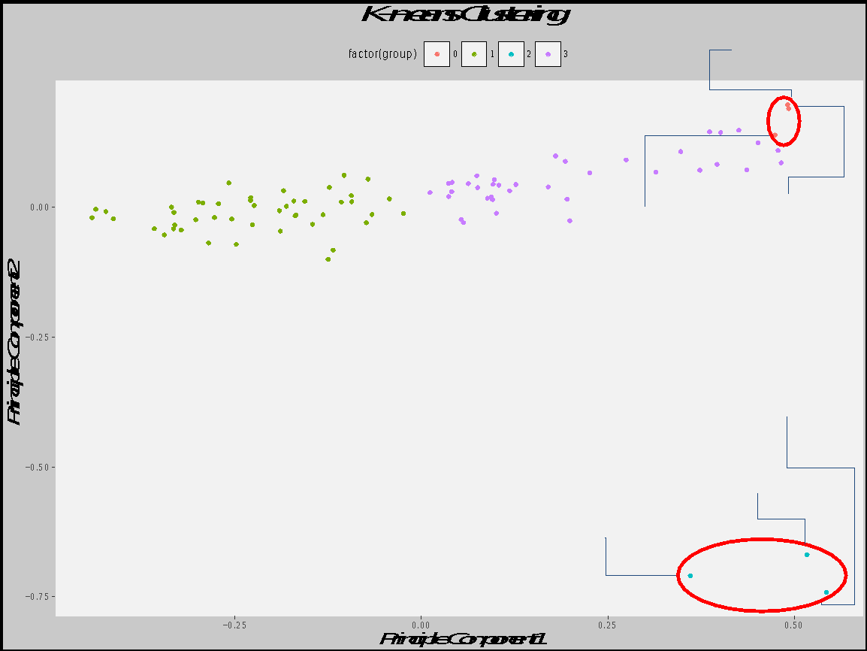
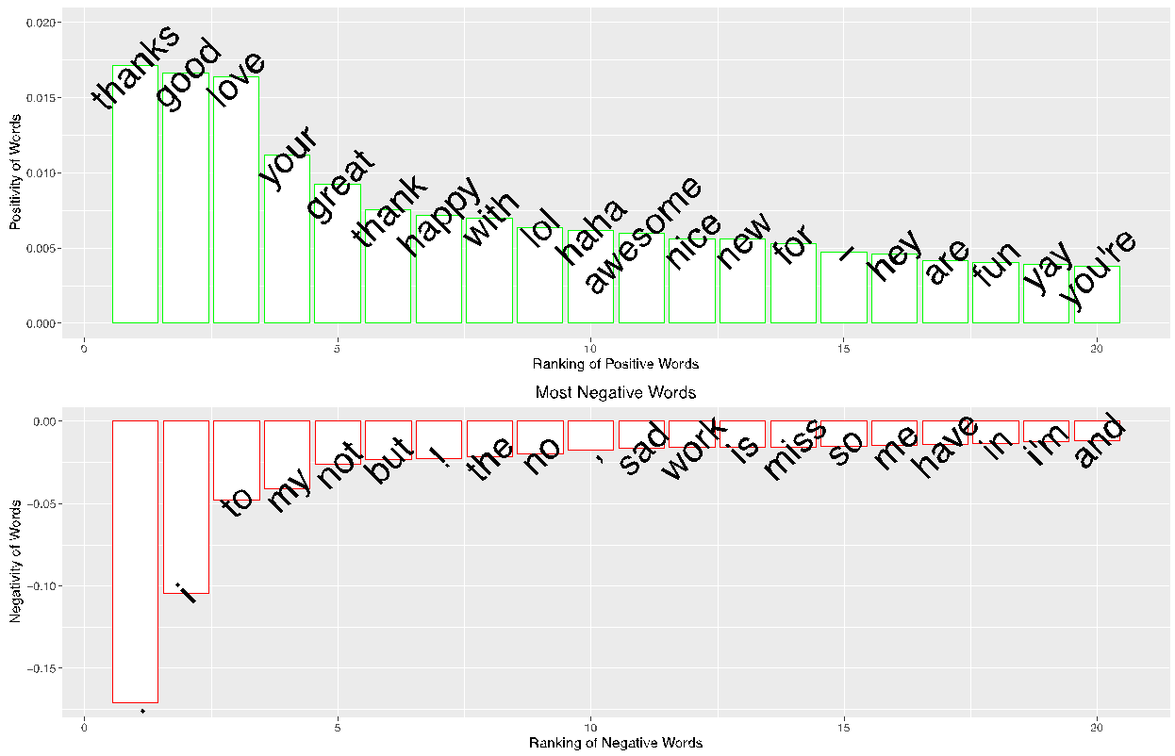
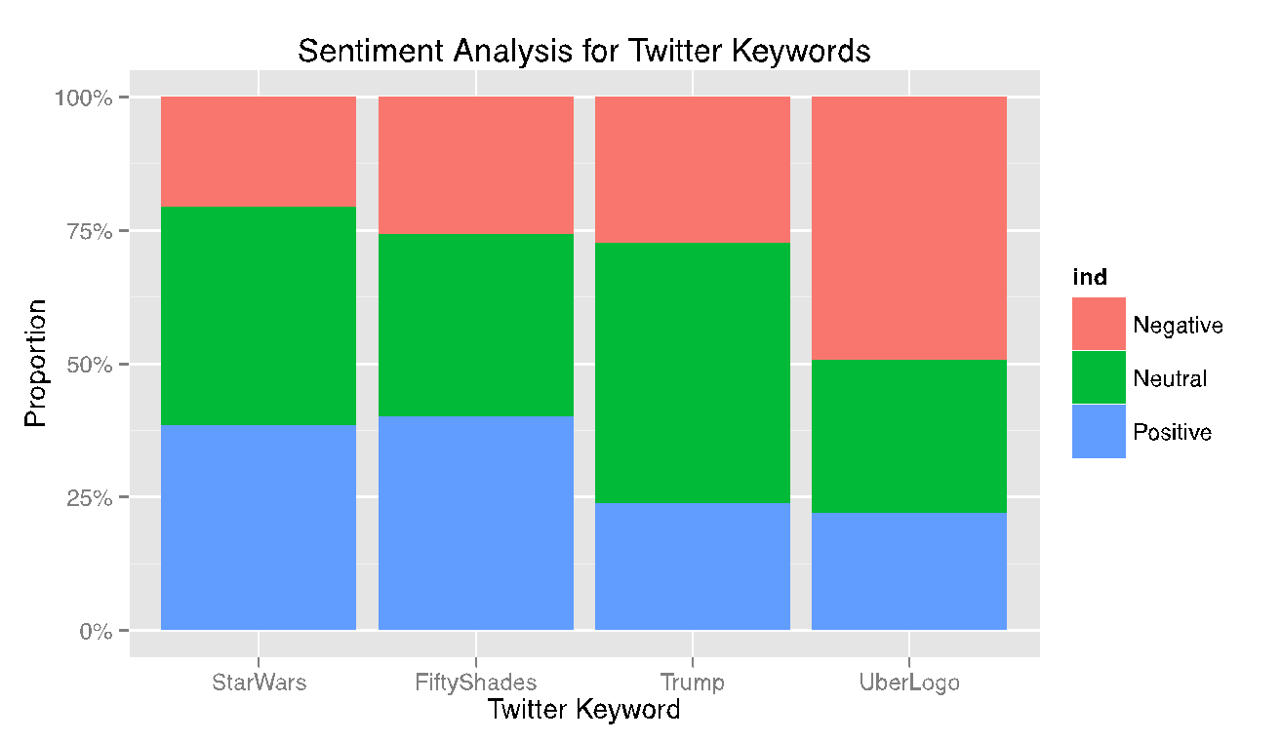
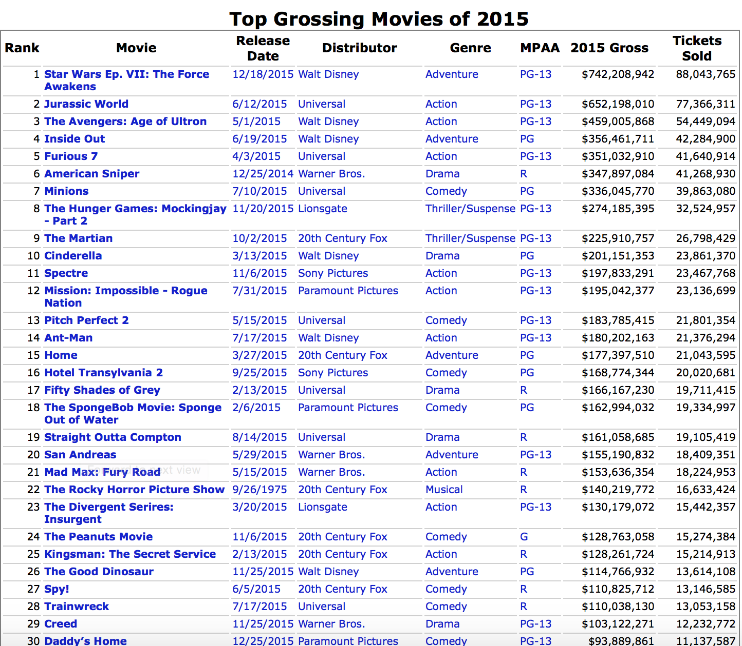
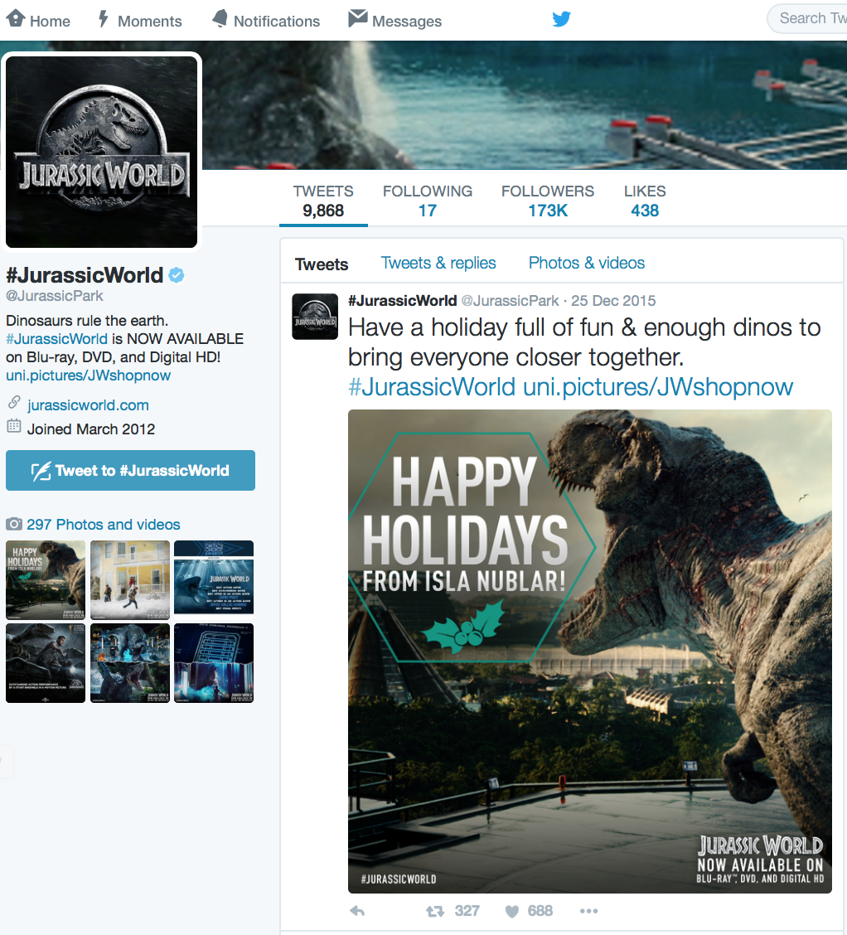
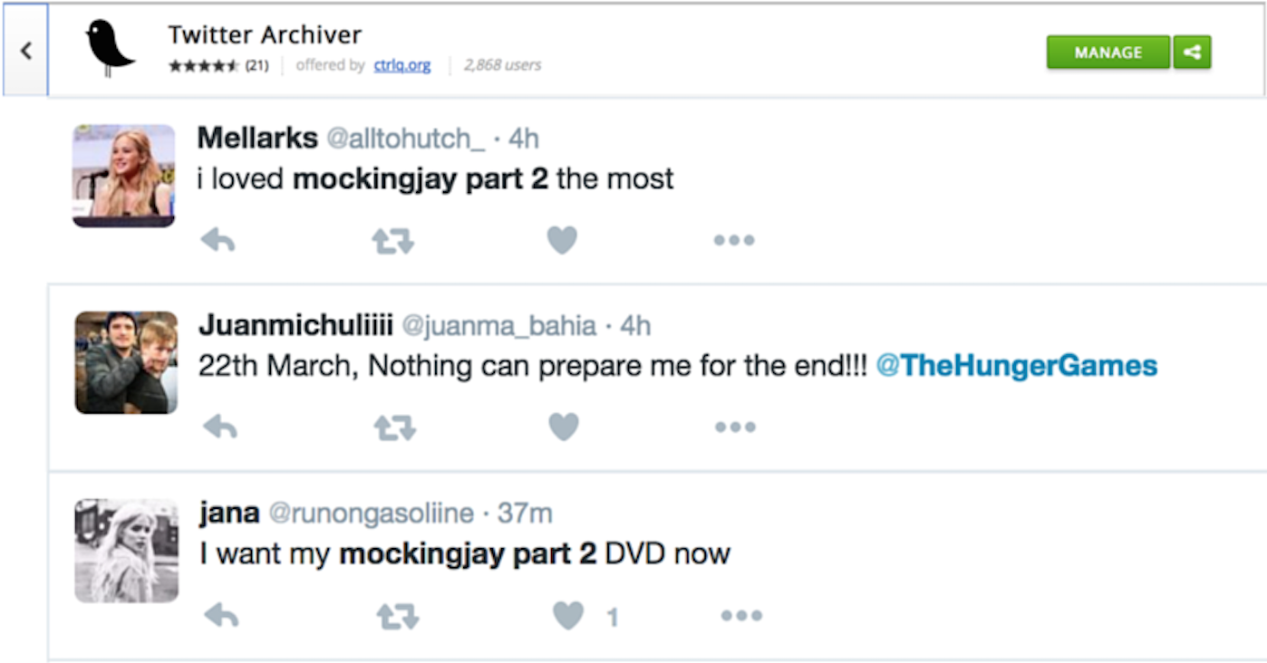

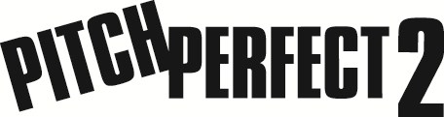
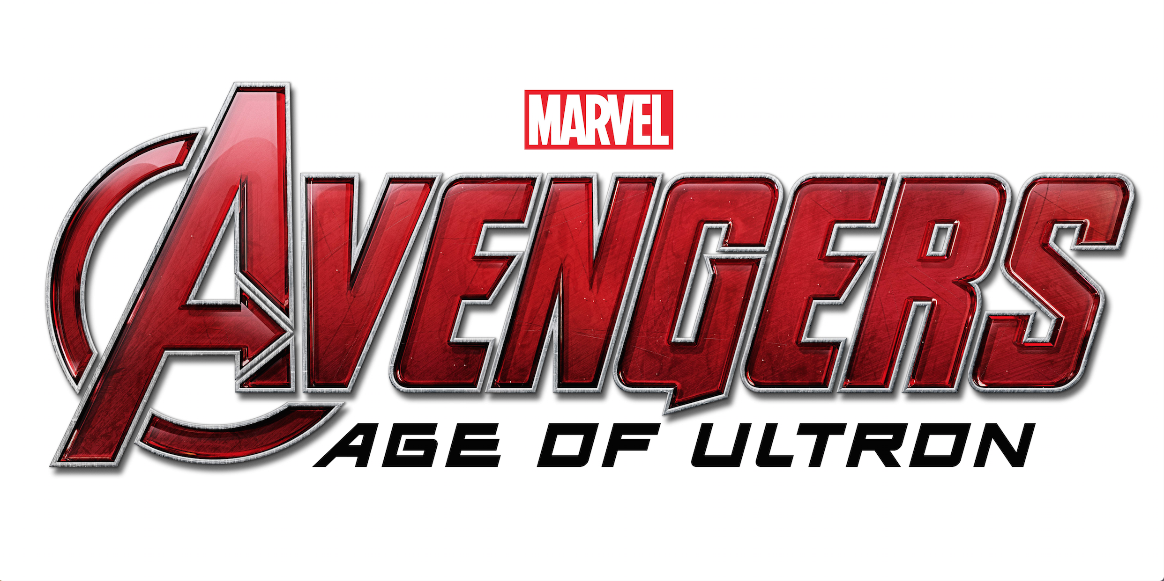
2015 Top 100 Grossing Movie Promotions on Twitter
Hoang Duong Trong, Cenzhuo Yao, Lu Zhang, Luyun Zhao, Sici Huang, Thibault Doutre
Motivation
Top Words/Hashtags
Promotion and Sales
Twitter is a continuously growing free online platform that enables users to reach out to over 300 million people around the world at anytime. With broadcasting to the proper audience base as one of their main concerns, filmmakers might ask: is Twitter an effective platform to promote movies?
The word cloud below shows the most frequently used words found in tweets from the 89 official movies accounts, where the size of the word is proportional to its frequency. All common stopwords (e.g. I, you, have, does, etc.) were excluded to ensure significance of the result.
The Correlogram below shows strong positive correlations between:
● number of followers on Twitter and movie’s box office result
● number of reviews on IMDB and movie’s box office result
● Confirmed:
Number of followers on Twitter and movie’s box office result are positively correlated .
● Predictable Outliers:
Ted2 has a large number of followers on Twitter but its sales were relatively low. One possible explanation is that people had high expectations based on the success of Ted1, but Ted2 failed to meet such expectations.
Analysis of the frequent hashtags reveals that all top 10 hashtags are movie names and were mostly used by the respective official movie accounts (as shown in Figure 1). After removing movie name hashtags, the result shows that 6 out of the top 10 hashtags were created in movie marketing campaigns (as shown in Figure 2).
The figure above shows that the number of official Twitter accounts for the top-grossing movies is steadily rising. In year 2015, 89 out of 100 filmmakers used a twitter account to promote their movie, which generated a total of 0.3 M tweets, 6M favorites, 8M retweets, and 11M followers online. Therefore, an increasing number of movie distributors find tweeting to be a suitable way to market their films.
● Confirmed:
Number of reviews on IMDB and movie’s box office result are positively correlated.
● Predictable Outliers:
The cluster contains four cartoon movies, the majority audience of which are children. Therefore, it makes sense that the movies didn’t receive many reviews despite their strong performances in the box office.
Objective
Figure 1: top 10 hashtags
● Each distributor has 5-17 movies in the top 100 grossing movies of 2015.
● One or two popular movies might dominate in the number of followers amogst the whole group.
Since Twitter has become an increasingly popular platform for film promotion, how do movie distributors use this resource effectively to help their movies succeed? Specifically, we want to analyze how Twitter movie promotion affects the Box office performance. To do so, we studied 89 of the top 100 grossing movies of 2015 that have official Twitter accounts and raised several questions:
● What are the most frequently used words by distributors? The top 10 hashtags?
● What are the different promotion styles used?
● How are the Twitter/IMDB account features related to Box office performance?
● What are the public opinions on these movies?
Figure 2: top 10 hashtags (adjusted)
Promotion Style and Sentiment Analysis
Data Source
● Twitter REST API: timelines and user info of the 89 official movie accounts
● Twitter Archiver Search API: public opinions on the 89 movies
● The-numbers.com: top 100 grossing movies of 2015 and their sales performances
● IMDB: ratings and reviews of the 89 movies
Figure: Most positive and negative words (measured by their correlations with positive and negative tweets)
We conducted the sentiment analysis of different Twitter keywords using text-processing.com API. Since running our own Random Forest algorithm on the labeled dataset only achieved a 75% accuracy on classifying positive and negative tweets, we decided to use a trained model from text-propressing.com instead. This model can classify a tweet along two dimensions—whether it is negative or positive, and whether the sentiment is neutral or intense. Specifically, if the intensity score is less than 0.5, the tweet is classified as neutral; otherwise, it is classified as either positive or negative depending on the positivity score.
Running k-means on the first 10 Principle Components shows that there are six outlier accounts who mostly spam their audiences while the other accounts seem to have similar promotion styles
We obtained a labeled dataset from Sentiment140.com, which contains 1.5 million tweets with labels of 0 for negative, and 1 for positive. Then, we constructed the bag of words matrix, with a vocabulary of 5000 words and ranked the words by their correlation with the sentiment labels to find the most negative and most positive words. Note one interesting fact that beside obviously positive words such as “happy“, “haha”, “lol”, words referring to other people or showing appreciation like “your”, “you’re”, and “thank” are also associated with positive tweets. On the other hand, words addressing oneself such as “I”, “me”, “my” are mostly linked to negative tweets.
@TashaPuffs Now you can get #PitchPerfect2! RT if you’re ready for more music 🎶 & extended scenes.
@_littlelena Now you can get #PitchPerfect2! Retweet if you’re ready for more music 🎶& extended scenes.
@DanyelleWadswo1 Now you can get #PitchPerfect2! Retweet if you’re ready for more music 🎶& extended scenes.
@sofiesdad08 Now you can get #PitchPerfect2! RT if you’re ready for more music 🎶 & extended scenes.
@OfficiallyMoye Now you can get #PitchPerfect2! RT if you’re ready for more music 🎶 & extended scenes.
@SapphireZebra It’s unlocked! Watch the new @Avengers trailer & get tix now.
@allanc234 It’s unlocked! Watch the new @Avengers trailer & get tix now.
@RhysMillham It’s unlocked! Watch the new @Avengers trailer & get tix now.
@Kebabycakes It’s unlocked! Watch the new @Avengers trailer & get tix now.
@loolz_7 It’s unlocked! Watch the new @Avengers trailer & get tix now.

